Slide 1




CAMIS: Comparing Analysis Method Implementations in Software
A PHUSE DVOST CAMIS working group in collaboration with PSI AIMS SIG
https://psiaims.github.io/CAMIS/
Project Objectives
To increase understanding and awareness of analysis result discrepancies across software (R, SAS, Python etc)
To explain to wider community why analyses method results differ
To provide solutions to make analysis results align (where possible, including R package selection)
To demonstrate the methodology through examples
To make efficient use of community resources to research differences
To document in open GitHub repository
To grow the repository, increasing quality and quantity of information
Apr2026

Slide 2

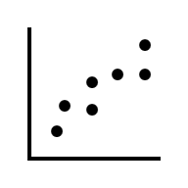
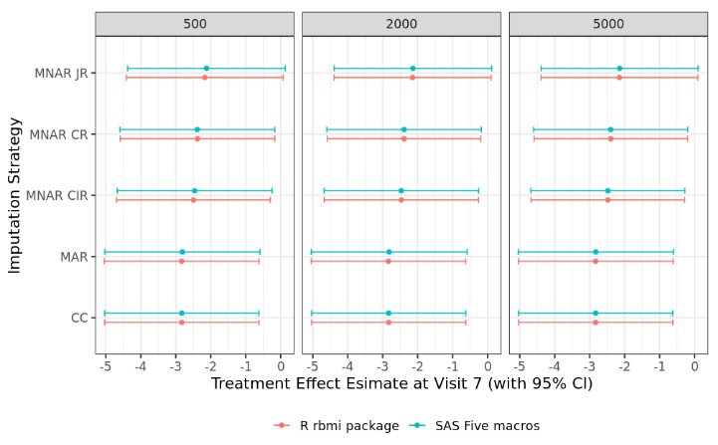
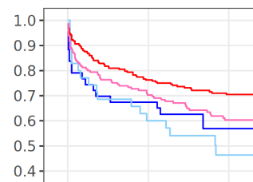

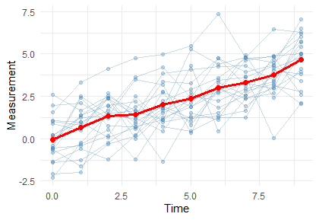

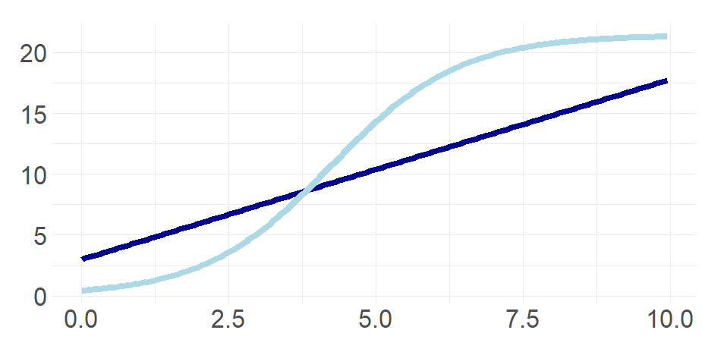
CAMIS: Comparing Analysis Method Implementations in Software
A PHUSE DVOST CAMIS working group in collaboration with PSI AIMS SIG
https://psiaims.github.io/CAMIS/
Analysis Method | SAS | R | Similar!?
Rounding | round(2.5) > 3 Rounding ‘away from zero’ | round(2.5) > 2 Rounding ‘to the even number’ | Not by default! SAS: use rounde function to round to event R: use janitor::round_half_up() to round away from zero
Cox PH regress-ion | proc phreg Default uses Breslow method for handling ties | survival::coxph() Default uses Efron method for handling ties | Not by default! SAS: include “TIES=EFRON” in MODEL statement R: include “ties=‘breslow’” in coxph() function {survival} prior to v3.8.0 can’t fit a stratification variable using “+survival::strata(<var>)”
Logistic regress-ion | proc logistic Default uses effect coding for categorical variables | stats::glm() Default uses glm coding for categorical variables | Not by default! SAS: include “PARAM=GLM” or “PARAM=REFERENCE” in CLASS statement R: No option to use effect parameterization
Analysis Method | SAS | R | Similar!?
Tobit regression | proc lifereg Important to use MODEL (lower, Y), when lower is missing, Y as a left-censored value | censReg:: censReg() survival:: survreg() | censReg() & survreg() match SAS NOTE: vglm() showed slight differences in Treatment effect & SE & P-value
Reference-based multiple imputation and tipping point | LSHTM five macros Rogers 2022 | rbmi package Implements standard and reference based multiple and tipping point using delta argument of the analyse() function | Yes. Within acceptable tolerance!
GEE Models | proc gee or proc genmod | geepack:: geeglm() | Yes ! SAS & R defaults are the same ‘independence’ correlation matrix and sandwich SE See CAMIS repo for more options & outcomes with >2 categories.
0 1 2 3 4 5 6 7 8 9
Regression + modelling censored variables
Regression + modelling censored variables
Apr2026

Slide 3
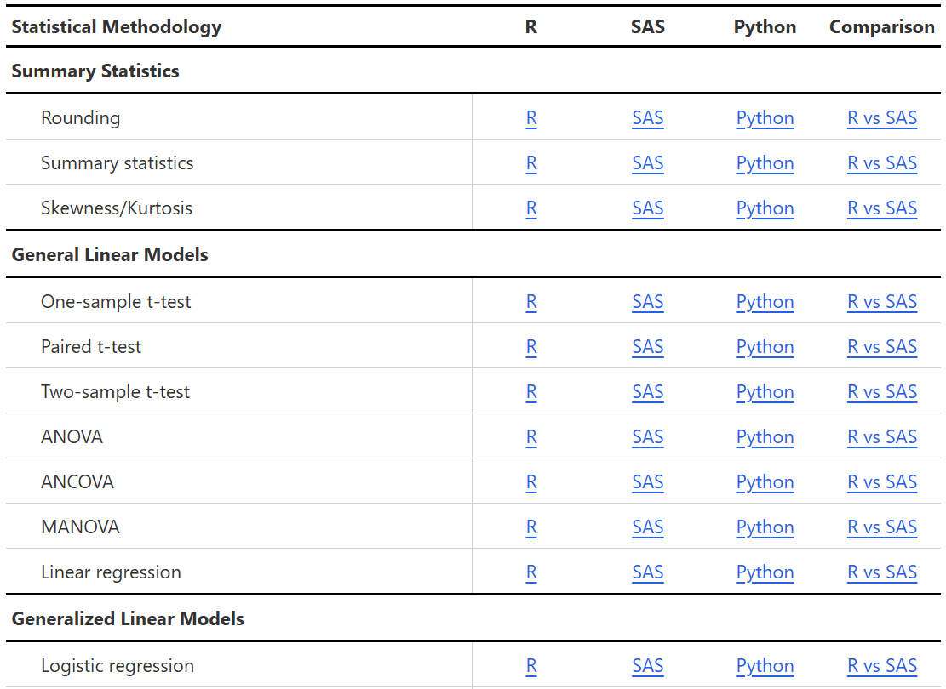
CAMIS: Comparing Analysis Method Implementations in Software
A PHUSE DVOST CAMIS working group in collaboration with PSI AIMS SIG
https://psiaims.github.io/CAMIS/
Regression + modelling censored variables
Apr2026

Slide 4
CAMIS: Comparing Analysis Method Implementations in Software
A PHUSE DVOST CAMIS working group in collaboration with PSI AIMS SIG
https://psiaims.github.io/CAMIS/
CAMIS project conclusions to date…
Generally, SAS & R align.
Discrepancies likely due to differences in default methodological choices or algorithmic variation
Sometimes there are differences in capabilities
It’s important to choose the right R package
Call to action: Please use and contribute to the CAMIS repo
New Pages Coming soon: CIs for proportions & CIs for rates
Regression + modelling censored variables
To join us, just fork the repo and start your contributions Contact lyn.taylor@parexel.com or christina.e.filmore@gsk.com or Yannick using: yvanden2@its.jnj.com for more information
Apr2026

